Slide 1
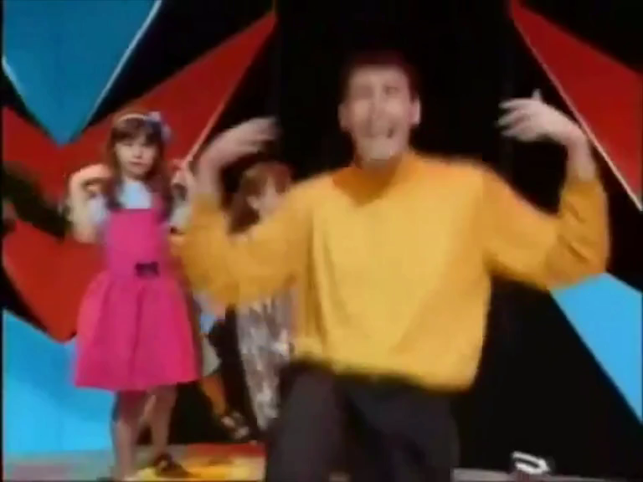
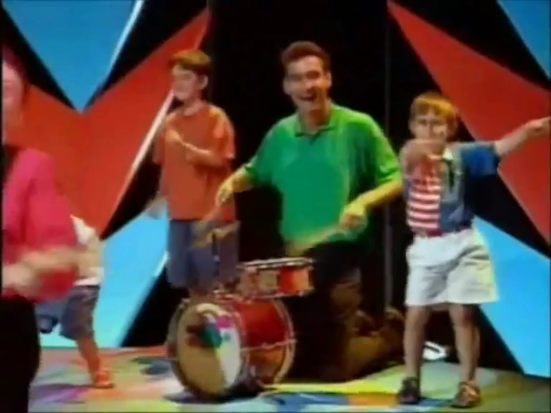
CAN YOU POINT YOUR FINGERS
Can you point your fingers & do the twist?
Can you point your fingers & do the twist?
Well we're going to go up
Then go down
Get back up
And turn around
Can you point your fingers & do the twist?
Can you stand on one foot & shake your hands?
Can you stand on one foot & shake your hands?
Now we're going to go up
Then go down
Get back up
And turn around
Can you stand on one foot & shake your hands?

